Slide 1
Contract Monthly Claim System
A Streamlined, Role-Based Web Application for Academic Claim Management
PROG6212
ST10451904
SIH-JIN LEE

Slide 2
Introduction
The Contract Monthly Claim System is a secure web application that modernizes the payment process for contract lecturers.
It replaces manual, error-prone methods with a centralized digital platform.
The system includes role-based dashboards for Lecturers, Program Coordinators, Academic Managers, and HR Administrators.

Slide 3
Introduction (cont.)
It guides claims through a structured workflow from submission to final authorization.
Key features include automated calculations, enforcement of business rules, transparent tracking, and secure document management.
The application reduces administrative overhead, minimizes errors, and ensures timely and accurate payments.

Slide 4
Login Page

Slide 5
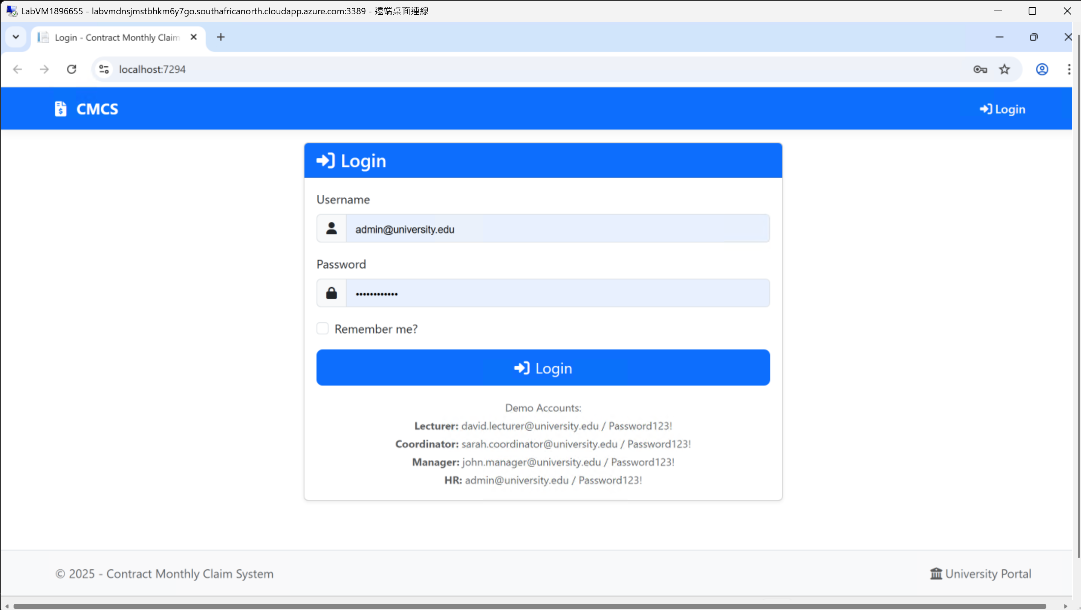
Login Page Features & Security
Clean, User-Friendly Interface
Simple and intuitive design for quick user login without confusion; fields for Username and Password are clearly labeled.
Secure Credential-Based Access
Requires users to log in with a unique username (email) and password to ensure authorized access.
Role-Based Demo Accounts
Pre-configured demo accounts for each user role (Lecturer, Coordinator, Manager, HR) to demonstrate core functionality and unique dashboards.
Centralized Authentication Gateway
A single login page that redirects users to personalized, role-specific dashboards after authentication.

Slide 6
Lecturer Dashboard

Slide 7
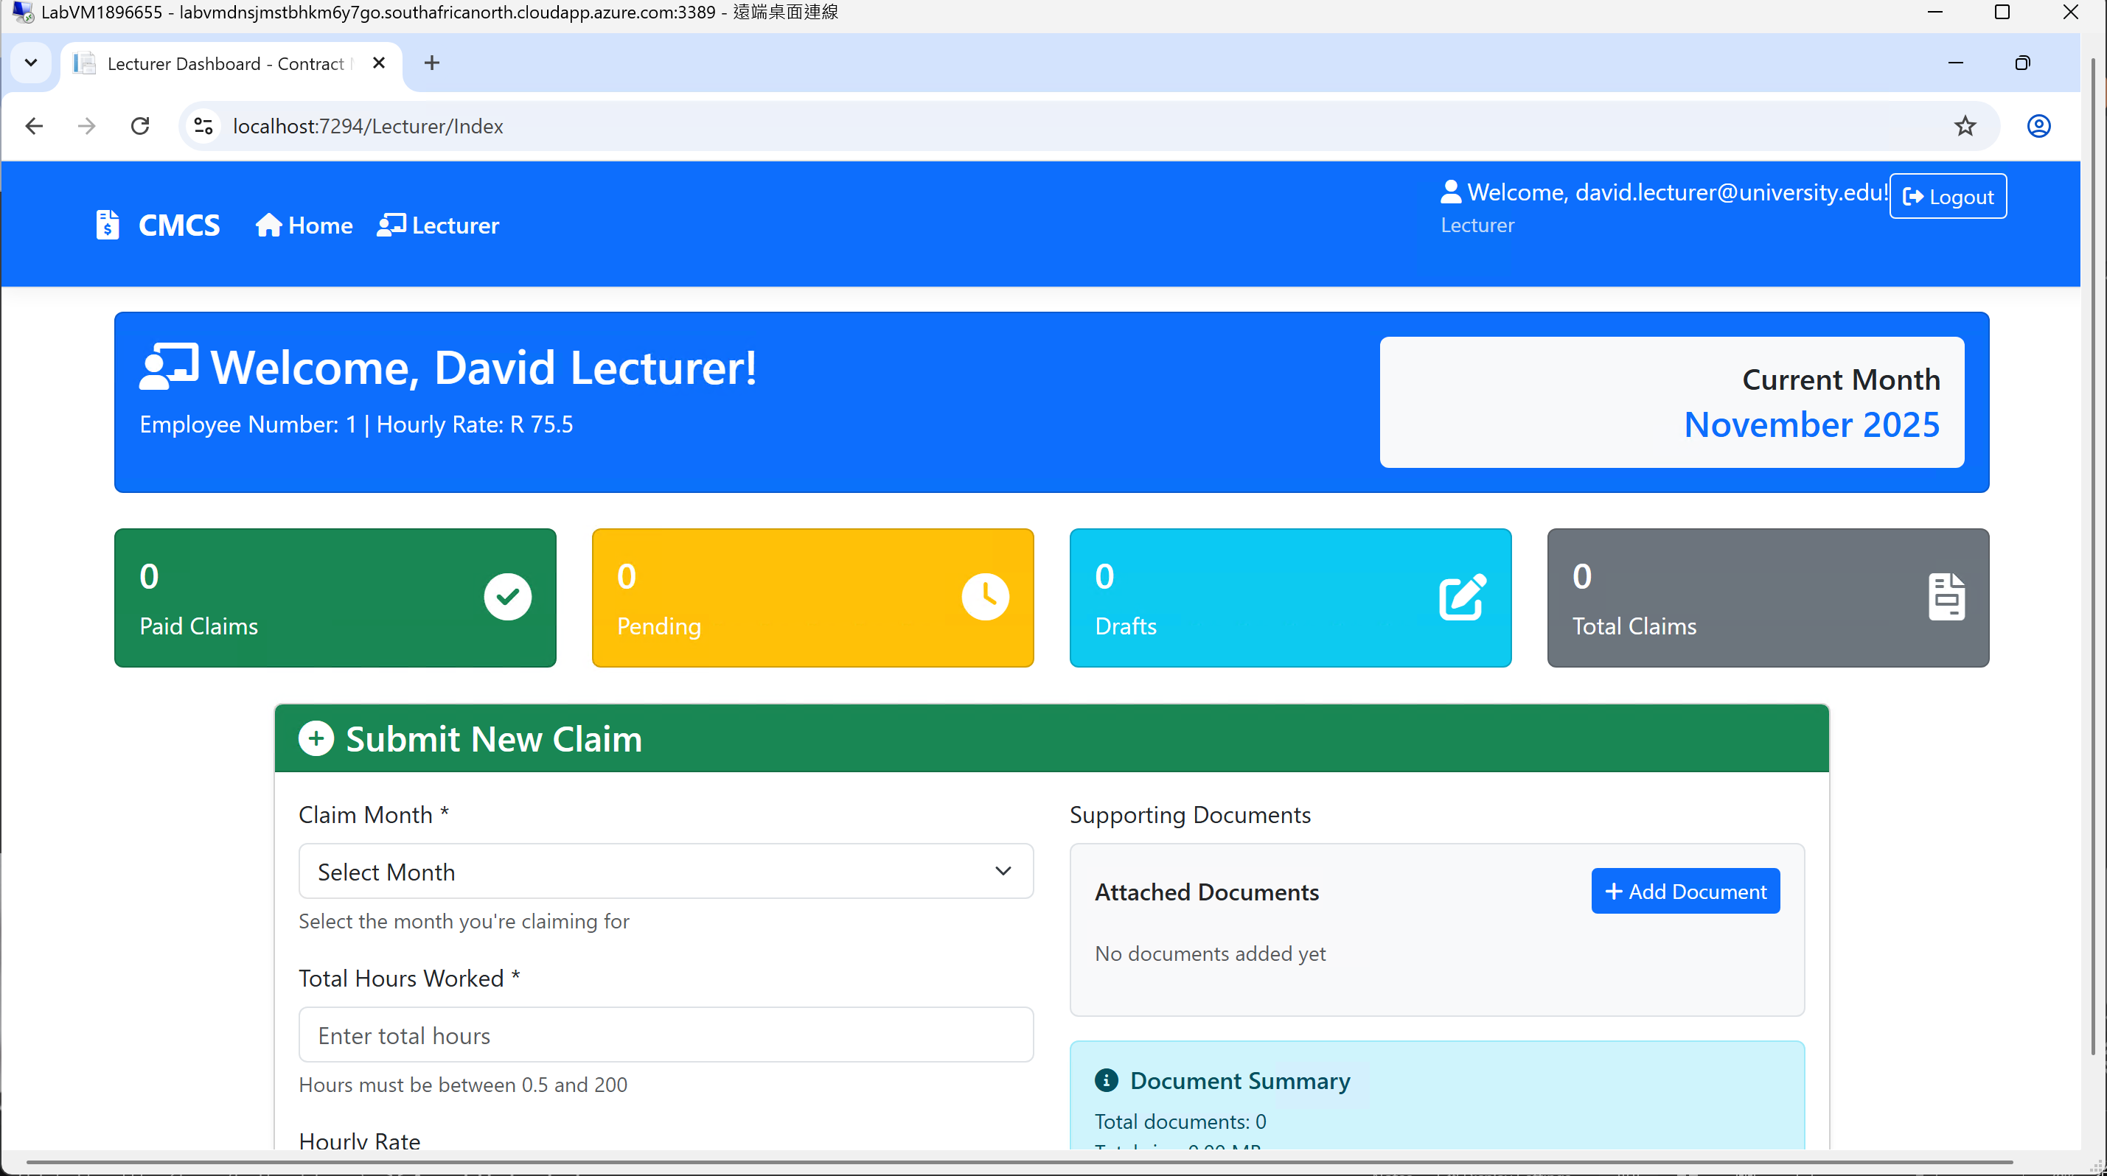
Lecturer Dashboard: Key Features & Functionality
Dashboard welcomes users by name, displaying key employment information, including Employee Number and contracted Hourly Rate (R 75.5).
Summary KPI Cards provide a quick overview of the lecturer's claim status: Paid Claims, Pending, Drafts, and Total Claims.
Integrated monthly claim submission form includes claim month selection and hours worked input with validation (0.5 to 200 hours).
Automated financial calculations display the user's Hourly Rate and estimated amount in real-time, ensuring clarity in payment calculations.

Slide 8
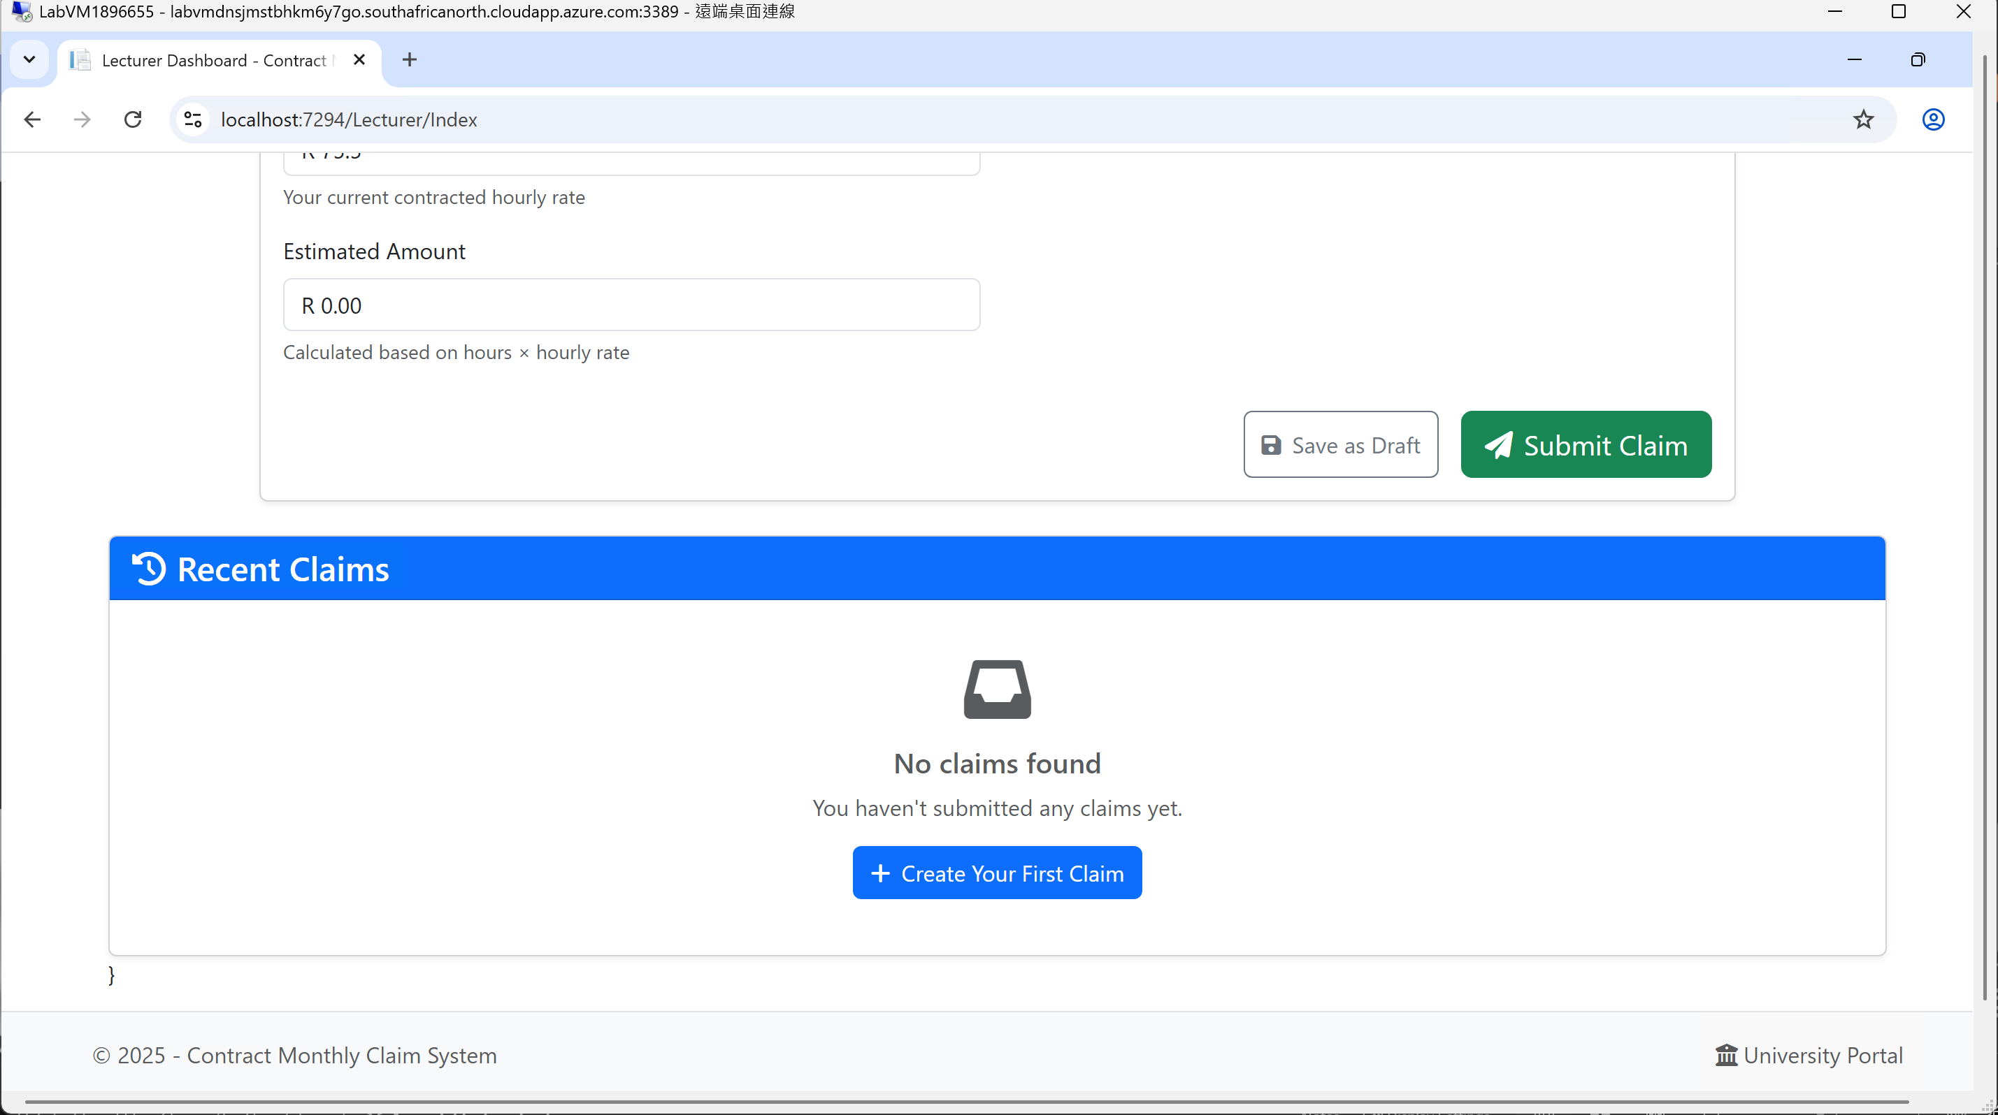
Lecturer Dashboard: Key Features & Functionality
Flexible submission workflow includes "Save as Draft" and "Submit Claim" buttons for streamlined claim management.
"Add Document" button allows attachment of supporting files, with a document summary panel for tracking attached documents.
Recent Claims History Panel shows the history of submitted, draft, and processed claims, encouraging new users to create their first claim if none are found.

Slide 9
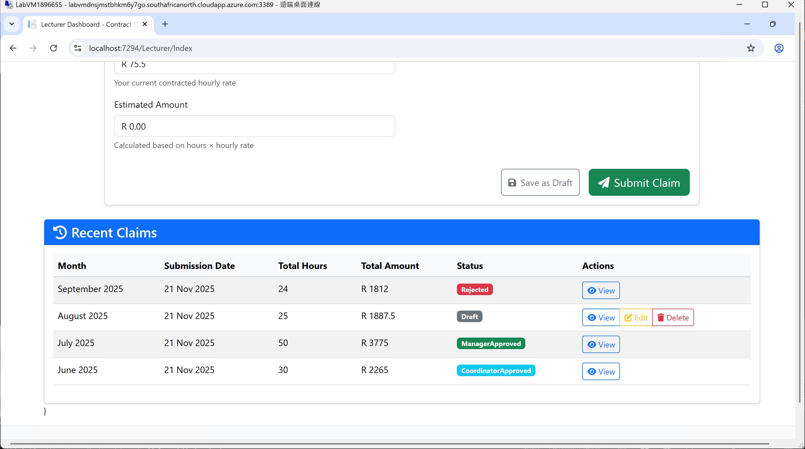
Lecturer Dashboard: Claims History & Management
Comprehensive Claims History Table
Offers an overview of all submitted claims for easy tracking by lecturers..
Visual Status Tracking
Draft: Claim is saved but not yet submitted for review (can still be edited).
Coordinator Approved: Claim has been approved by the program coordinator and is pending final manager approval.
Manager Approved: Claim has been fully approved and is ready for payment.
Provides immediate visibility into the approval pipeline.
Context-Aware Action Buttons
View: Available for all claims, allowing lecturers to see full details.
Edit & Delete: Only available for "Draft" claims, giving lecturers full control over unsubmitted work.
Automated Permissions: Actions are dynamically restricted based on claim status (e.g., a submitted claim cannot be edited or deleted).

Slide 10
Coordinator Dashboard

Slide 11
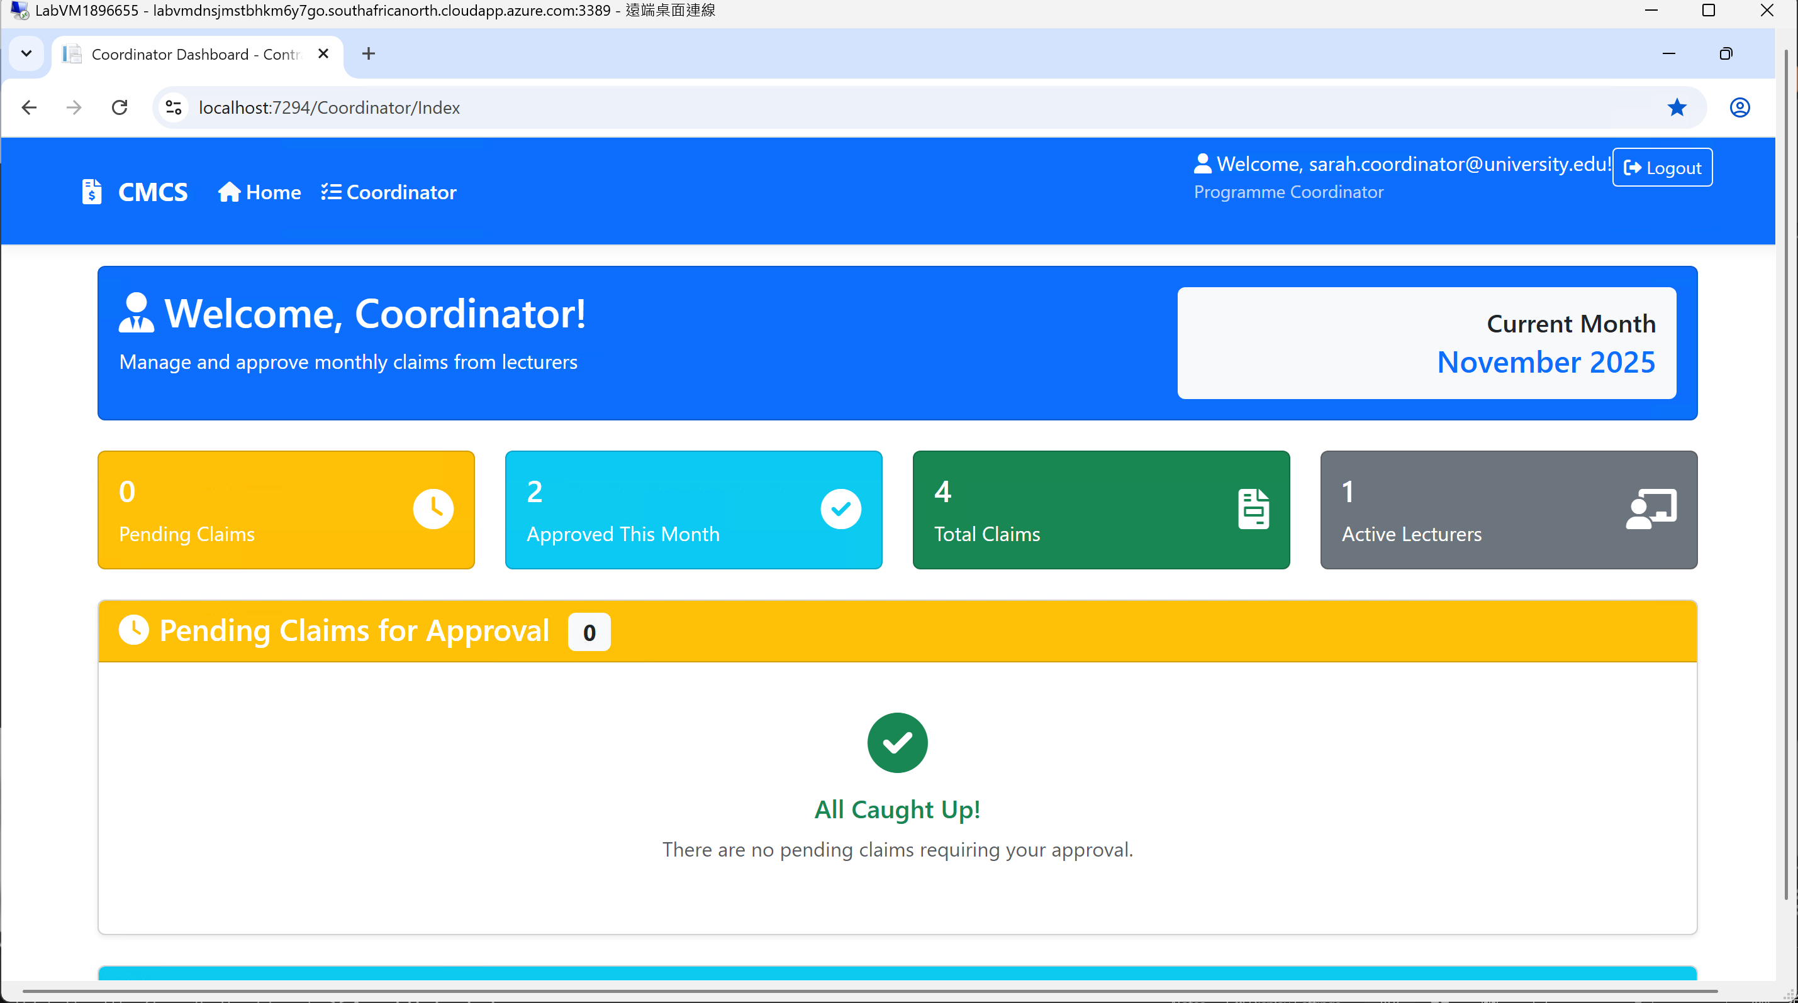
Coordinator Dashboard: Efficient Claim Oversight
Dashboard tailored specifically for the Coordinator role.
Primary function: Manage and approve monthly claims from lecturers.
Summary KPI Cards for operational overview:
Active Lecturers: Number of lecturers managed.
Approved This Month: Monthly productivity tracking.
Total Claims: Overall processed claims volume.
Clear "Pending Claims" workflow with actionable tasks.
Positive reinforcement message "All Caught Up!" when no backlog exists.

Slide 12
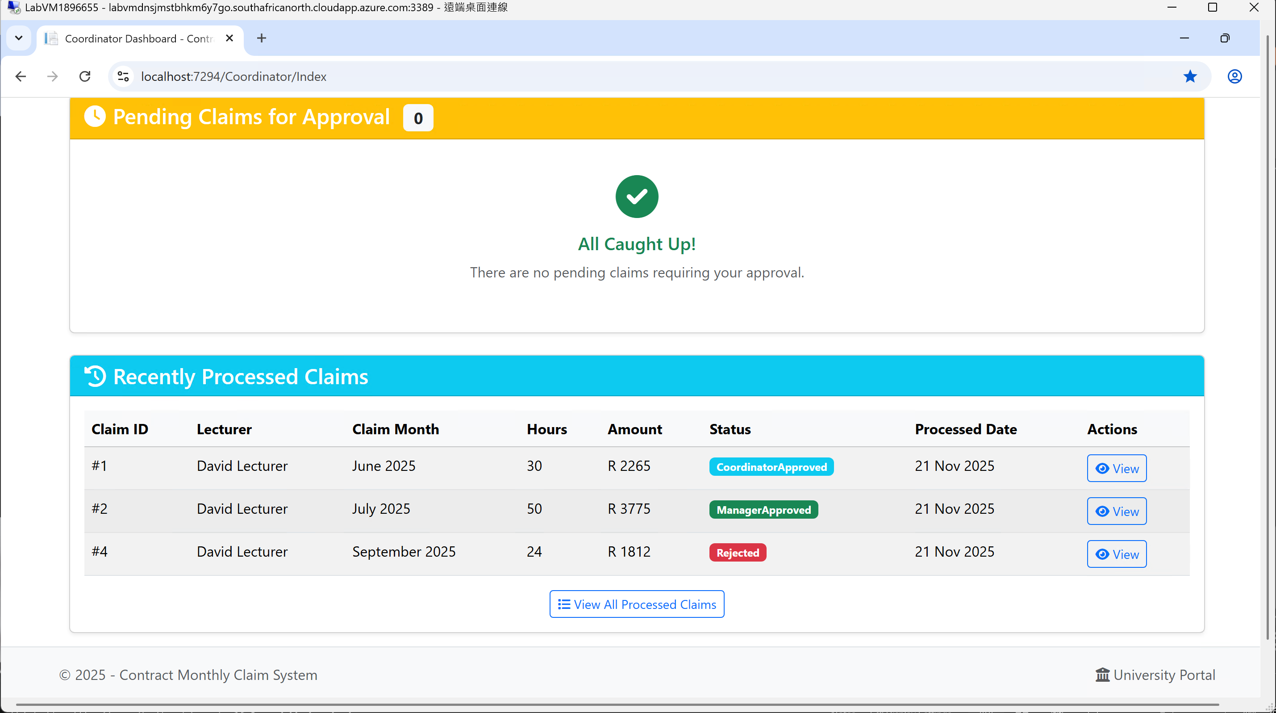
Coordinator Dashboard: Efficient Claim Oversight
Recently processed claims history tracking key information:
Lecturer, Claim Month, Hours, Amount, and Status.
Visual multi-stage status tracking for claims:
Coordinator Approved, Manager Approved, and Rejected stages.
Easy access for review & auditing through "View" Action button on claims.
"View All Processed Claims" link for full history access for deeper auditing.

Slide 13
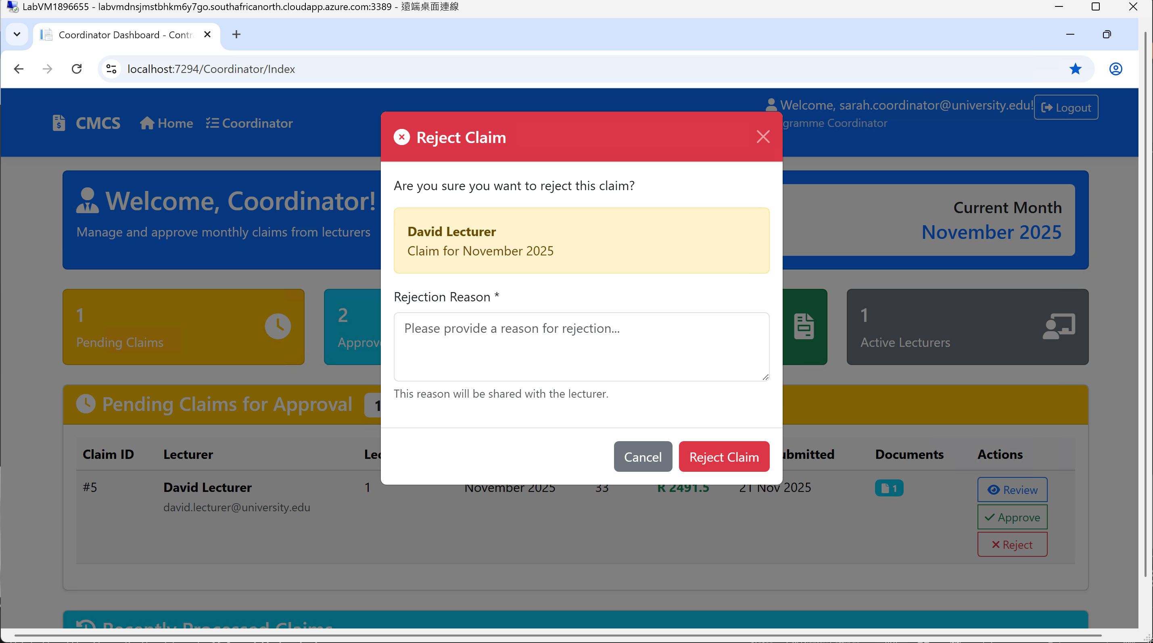
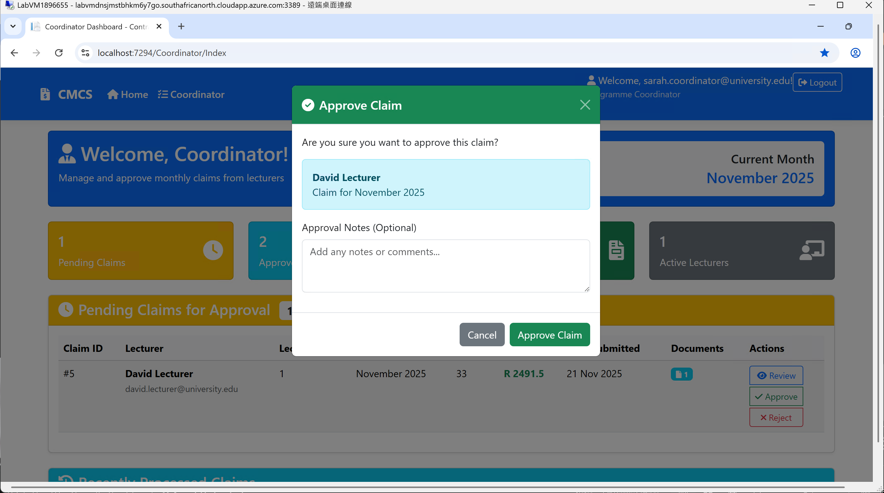
Coordinator Dashboard: The Approval Workflow
Action-oriented table lists pending claims from lecturers for review.
Displays key claim details: Lecturer, Claim Month, Hours, Amount, and Submission Date.
Quick-action buttons for processing claims include:
Review: View full claim details and documents.
Approve: Start approval process for valid claims.
Reject: Start rejection process for invalid claims.
Structured approval process includes confirmation dialog upon approval.
Optional notes can be added for coordination and management records.
Rejection process requires mandatory reason, shared with lecturers for transparency.
Key claim information is displayed during approval and rejection to prevent errors.

Slide 14
Manager Dashboard

Slide 15
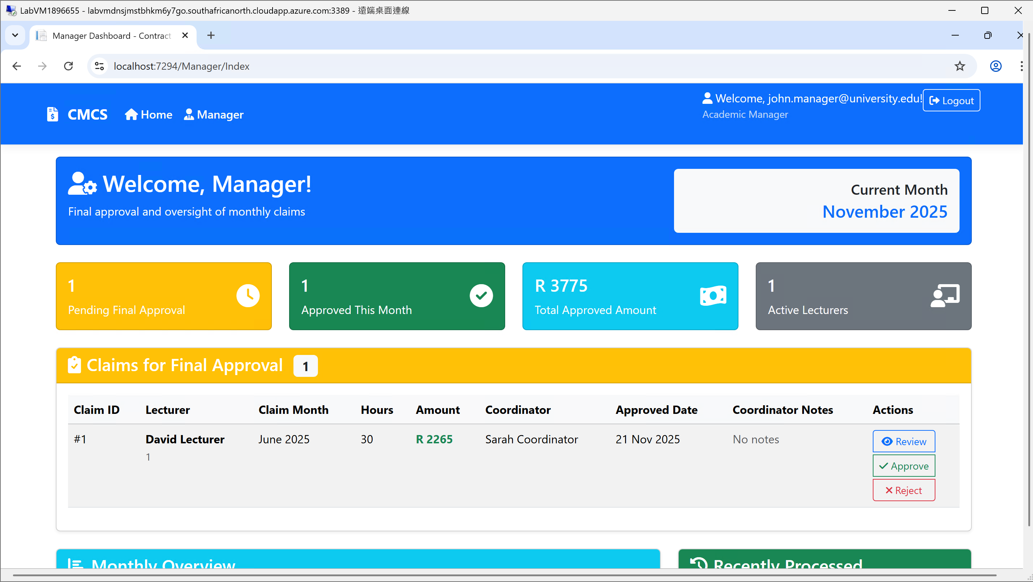
Manager Dashboard: Final Approval & Oversight
Clear welcome stating the manager's role: "Final approval and oversight."
Final Approval Queue
A dedicated list of claims that have been approved by coordinators and are now awaiting the manager's final decision.
Shows the coordinator's name and approval date, creating a clear audit trail.
Informed Decision-Making
The table includes "Coordinator Notes" so the manager can see why the coordinator approved it.
Provides all necessary context (Lecturer, Month, Hours, Amount) for a final review.
Quick Action Buttons
Review: To examine claim details and documents.
Approve: To give final approval and release payment.
Reject: To deny the claim even after coordinator approval.

Slide 16
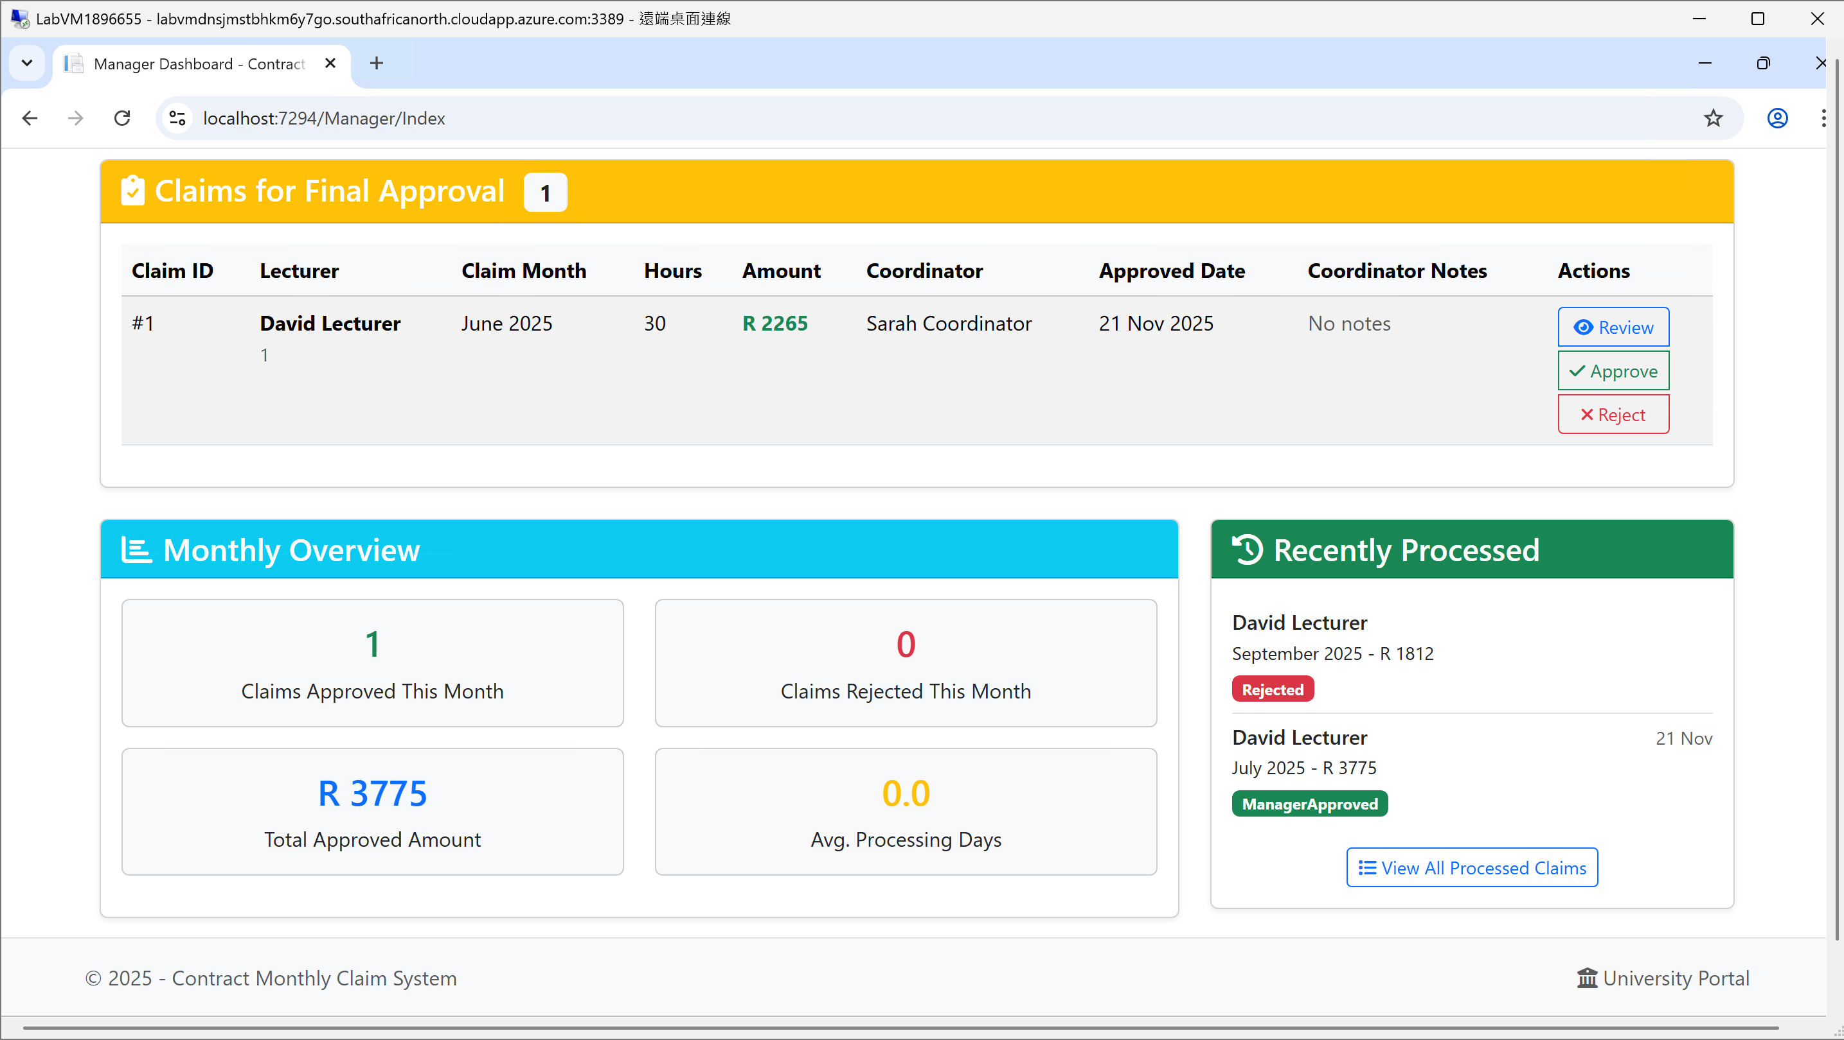
Manager Dashboard: Final Approval & Oversight
Performance Tracking
Tracks "Avg. Processing Days" to monitor workflow efficiency.
Shows a list of "Recently Processed" claims for quick reference.
"View All Processed Claims" provides access to full history for reporting.

Slide 17
HR Dashboard

Slide 18
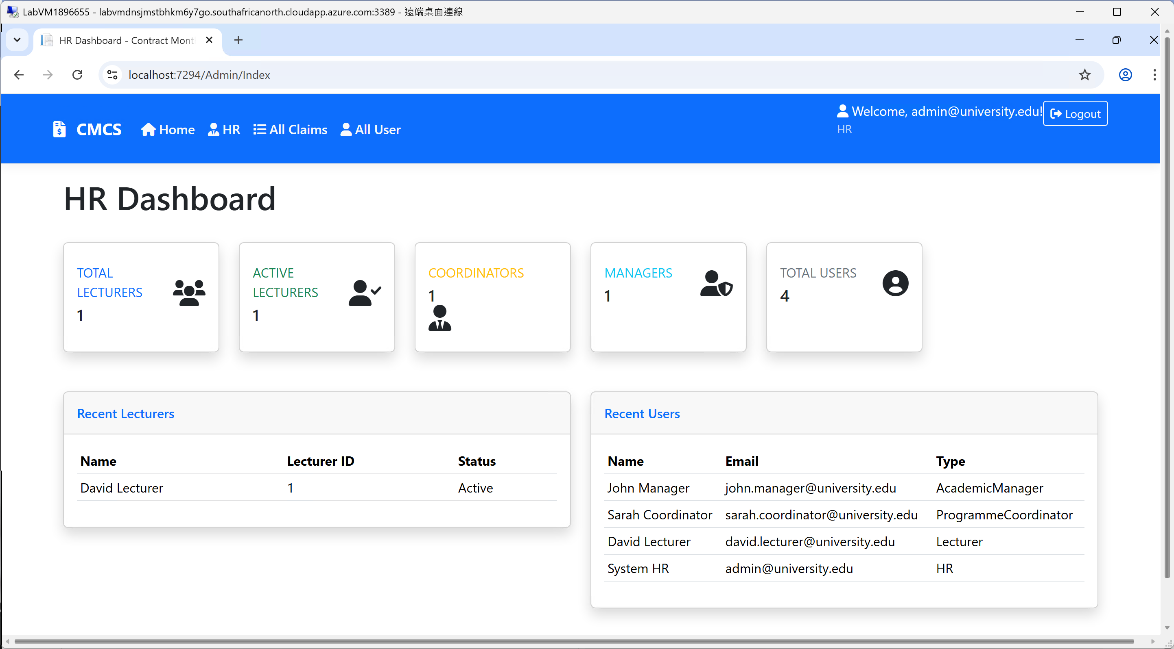
HR Dashboard (HR): Centralized User Management
Top Navigation Bar
All Claims: View every claim in the system.
User List: Manage all user accounts.
System-Wide User Statistics
High-level overview of all users in the system.
Tracks totals for: Lecturers, Active Lecturers, Coordinators, Managers, and Total Users.
Centralized User Directory
"Recent Lecturers" section shows the latest teaching staff added to the system.
"Recent Users" section displays all recently created user accounts across all roles.
Quick Status Monitoring
Shows the active/inactive status of lecturers at a glance.
Allows HR to quickly see which accounts are operational.

Slide 19
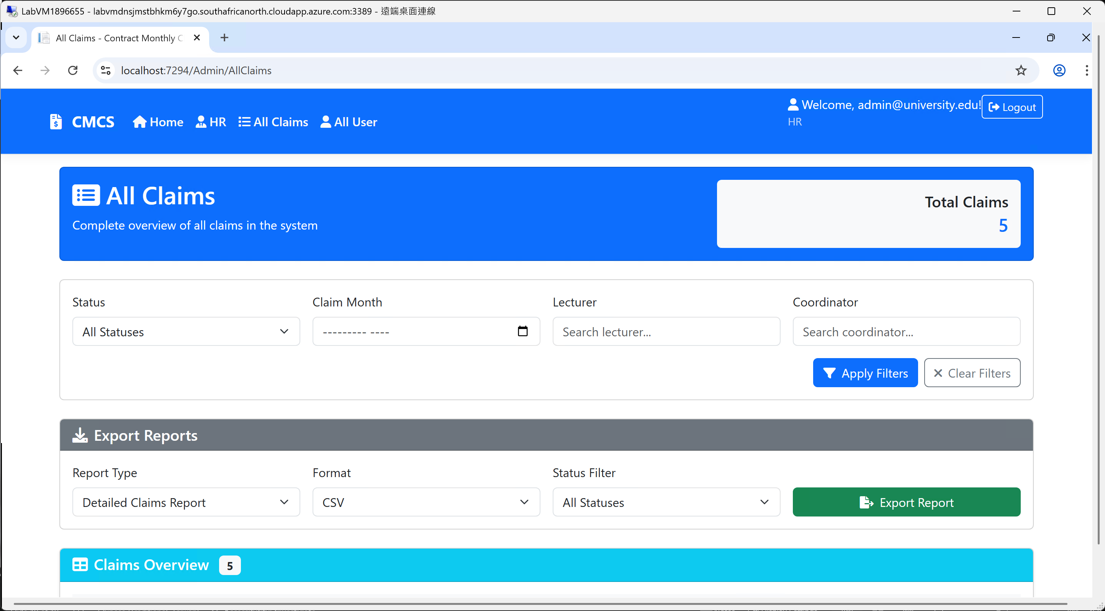
HR Dashboard (All Claims): Advanced Claims Management & Reporting
Complete System-Wide Claims View
HR can see every claim in the system, regardless of its status or who submitted it.
A true "God's eye view" for total administrative oversight.
Advanced Filtering & Search
Filter claims by Status, Month, Lecturer, or Coordinator.
Search boxes allow for quick finding of specific people.
"Apply Filters" and "Clear Filters" buttons for easy control.
Data Export for Reporting
Export functionality to download claim data.
Can generate a "Detailed Claims Report" in CSV format for use in Excel or other systems.
Enables easy analysis and record-keeping for the finance department.

Slide 20
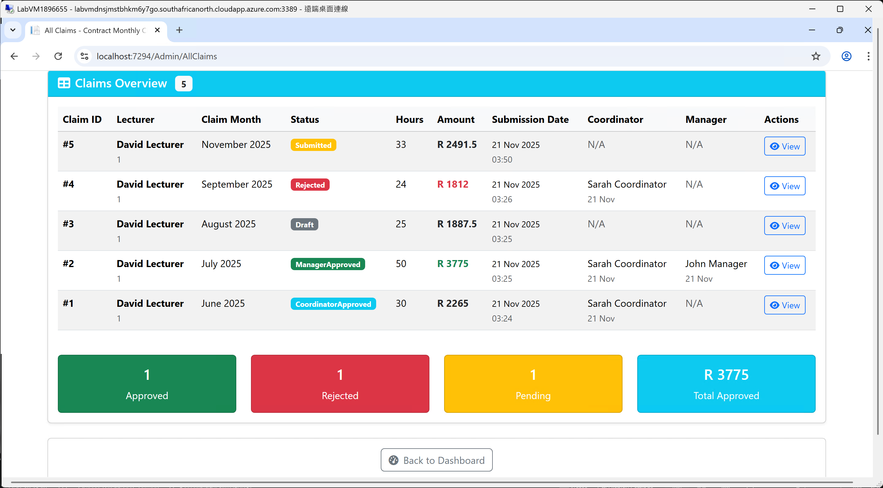
HR Dashboard (All Claims): Advanced Claims Management & Reporting (cont.)
End-to-End Audit Trail
The table shows the entire approval chain for each claim.
Tracks the Coordinator and Manager involved, along with their approval dates.
Provides complete transparency for auditing purposes.
Quick Status Summary
A summary showing totals for Approved, Rejected, and Pending claims.
Displays the Total Approved Amount for a quick financial snapshot.

Slide 21
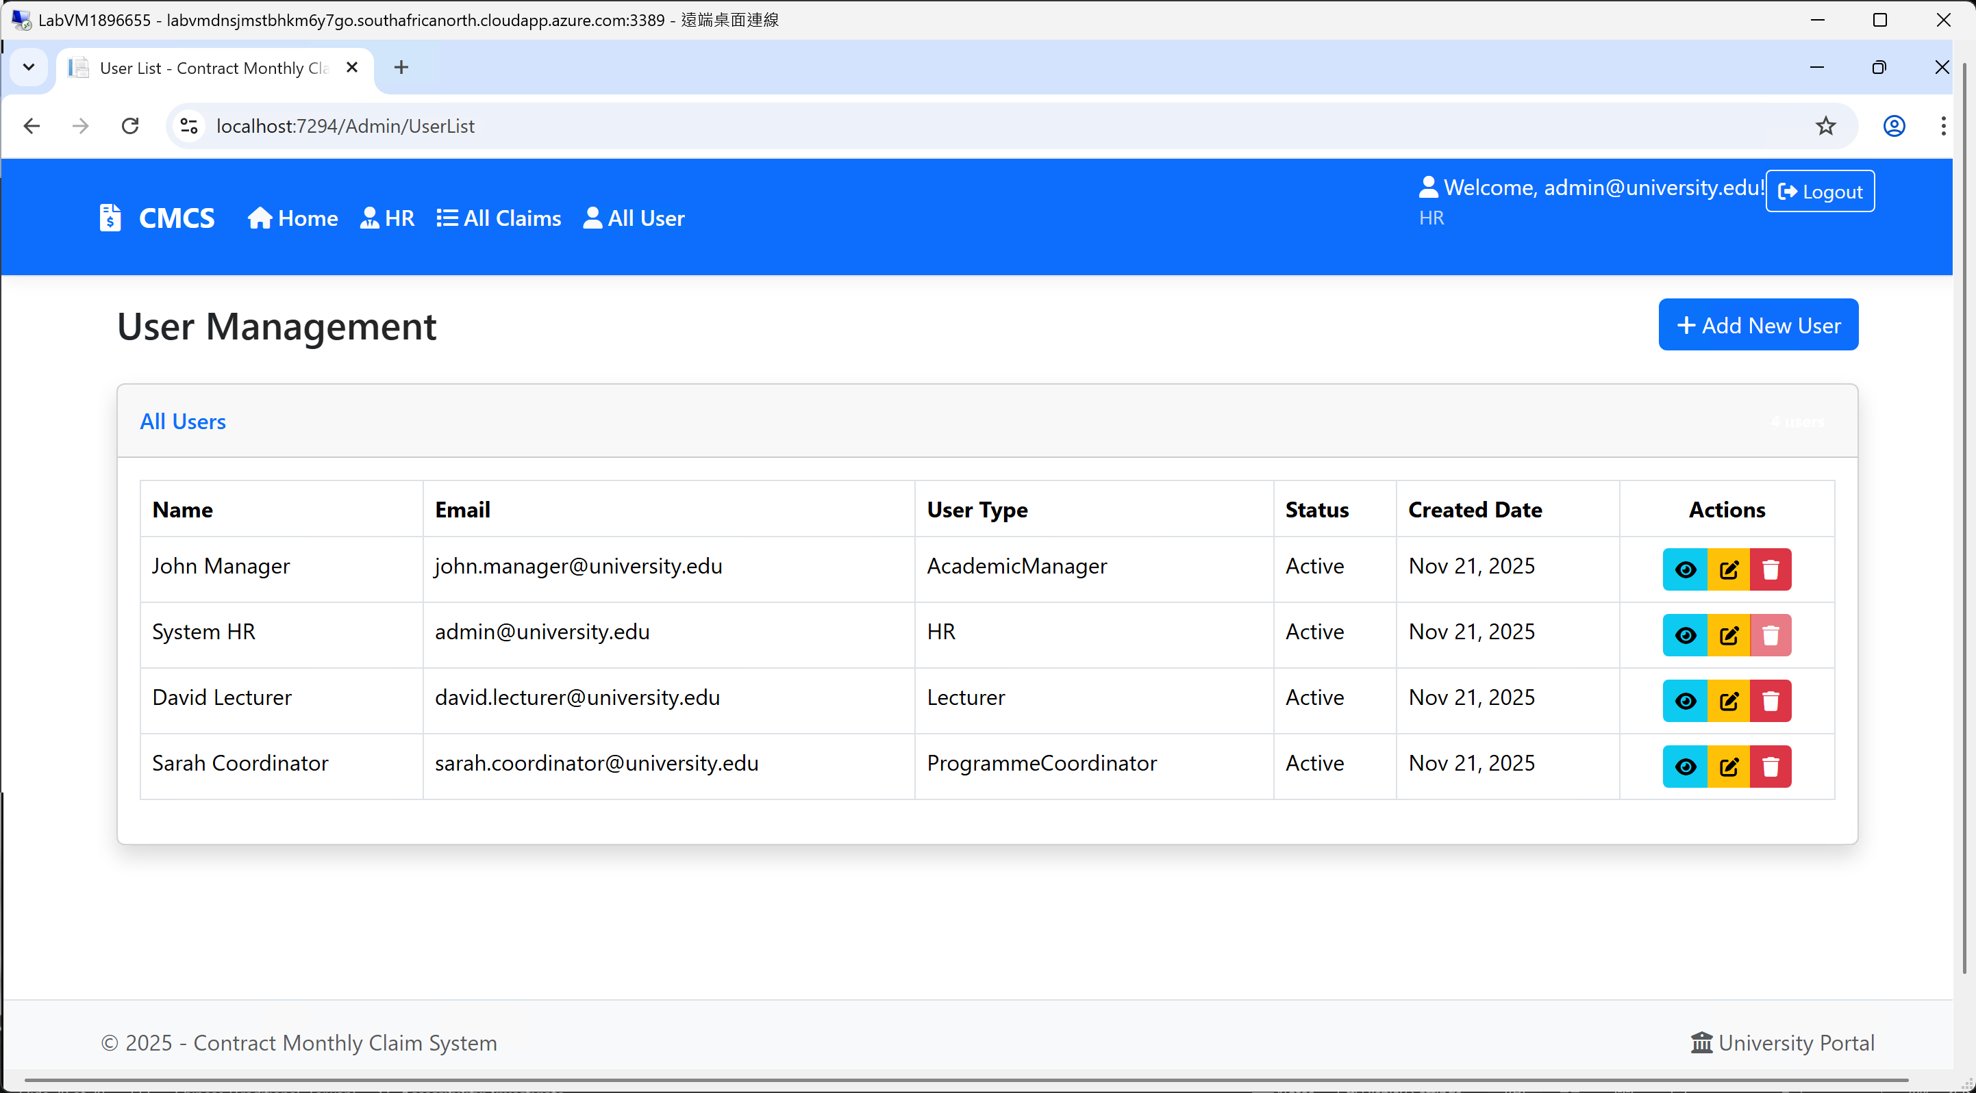
HR Dashboard (All User): Centralized User Administration
Complete User Directory
View all system users in one centralized table.
Role-Based User Management
Clear identification of User Type (HR, Academic Manager, Program Coordinator, Lecturer).
Track Active/Inactive status for all user accounts.
Full Administrative Controls
Action icons for Edit, View, and Delete user accounts.
Quick User Creation
"+ Add New User" button for easily creating new accounts.

